Slide 1


ASTROSAGE
ANALYSIS
Abhishek Ghosh
22/01/2025

Slide 2

Problem Statement
AstroSage has secured a 1 crore investment and is focused on optimizing its call center operations. The objective is to strategically allocate this investment in a way that enhances operational efficiency, boosts customer satisfaction, and increases profitability. The analysis will take into account historical call data, performance metrics, and market trends to drive data-driven decisions.

Slide 3

AstroSage: Personalized Astrology
Leading online astrology platform offering personalized services.
Aims to make astrology accessible to all, providing insights into life, relationships, and career.
Connects users with experienced astrologers for live consultations via chat, call, or video.
Offers variety of services including horoscope readings, Vedic astrology, and numerology.
Focus on customization ensures personalized guidance for each user.

Slide 4
How AstroSage Works
User Registration and Profile Setup
AstroSage users create profiles with birth details and service preferences.
05
Post-Consultation Services
Users review astrologers and save session details. AstroSage provides follow-up services.
01
04
Select Astrologer or Service
Users choose astrologers based on expertise, ratings, and availability.
Receive Personalized Guidance
Users receive personalized astrological guidance, including horoscopes, Vedic astrology insights, or numerological advice.
02
03
Book a Consultation
Users schedule consultations via chat, call, or video.

Slide 5

AstroSage Data Overview
Key Performance Indicators (KPIs)
Engagement: Over 26K monthly users.
Agents: 131 dedicated agents.
Revenue: Monthly revenue over 2 lakhs.
Investment: 1 crore investment for business optimization.
Data Cleaning and Preprocessing
Attribute Removal: Removed non-informative columns.
Data Consistency: Standardized guruName formatting.
Data Cleaning: Removed unwanted characters and handled missing values.
Data Utilization
Business Analysis: Deep dive into AstroSage's business model.
Key Insights: Understand user behavior, internal challenges, and areas for improvement.
Investment Guidance: Identify strategic areas for resource allocation.

Slide 6
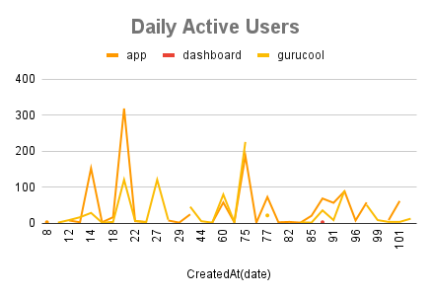
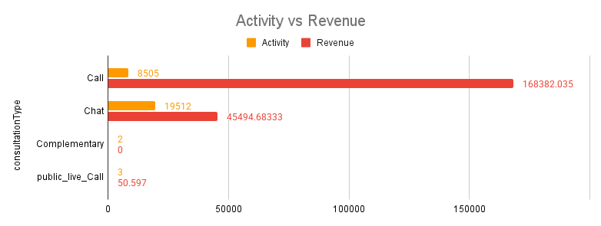
Daily Calls Analysis
Trend: Decreasing daily call volume.
Revenue Impact: Significant revenue contribution from calls.
Urgency: Immediate attention required to mitigate business impact.
Root Cause Analysis: Deeper analysis to identify underlying issues.
Temporary Solution: Introduce attractive offers to stimulate demand.
Long-Term Solution: Identify root causes to guide effective resource allocation.

Slide 7
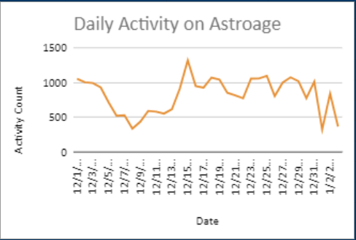
Average Call Handled Per Agent Per Day
Average Calls per Agent: 1.91 calls per agent per day (low).
Potential Issues: Indicates low user base or traffic.
Compounding Problem: Combined with decreasing call volume, signals serious business concerns.
Urgent Action: Continuation of this trend could be disastrous.
Temporary Solution: Increase marketing efforts and introduce attractive offers.

Slide 8
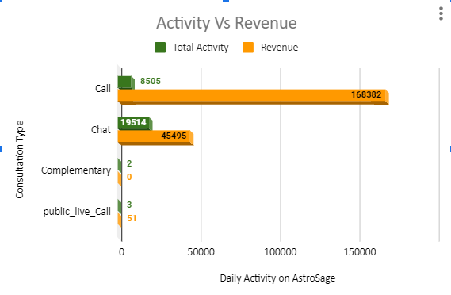
Chat/Call Revenue Analysis
Activity: Higher chat activity (19,514) compared to calls (8,505).
Revenue: Lower chat revenue (₹45,495) compared to calls (₹168,382).
Gap: Chat popularity doesn't translate to revenue.
Suggestion: Enhance chat interface with features like instant horoscopes, follow-up sessions, and real-time document sharing to boost user satisfaction and retention.

Slide 9
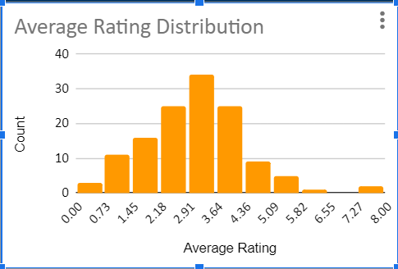
Average Rating Analysis
Indicator: Average user rating reflects user experience and likelihood of revisits.
Interpretation: Higher ratings indicate positive experiences, lower ratings suggest negative ones.
Concern: Majority of ratings (below 3.64/8) indicate subpar user experiences.
Potential Issue: Agent-provided resolutions may be contributing to dissatisfaction.

Slide 10
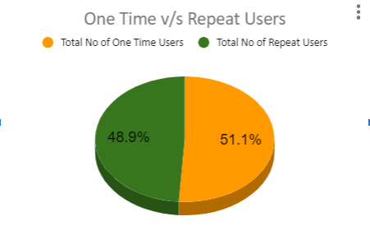
User Engagement Analysis
Key Insights:
One-Time Users: 51.1% of total user base.
Repeat Users: 48.9% of total user base.
Recommendations:
Improve First-Time User Experience: Enhance onboarding and post-service follow-up.
Implement Loyalty Programs: Offer incentives for repeat users.

Slide 11
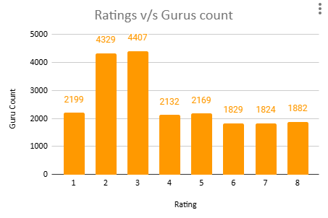
Ratings v/s Guru count analysis
Key Insights:
The majority of gurus lie between 2 and 4, with peak at rating 3 (4,407 gurus).
Fewer gurus in the higher rating brackets (5 to 8), indicating room for improvement
Comparatively, small number of gurus have achieved top ratings
Recommendations:
Implement targeted training programs for gurus with low to mid-range ratings (2-4) to enhance customer interactions.
Introduce performance-based incentives to motivate gurus to aim for higher ratings.

Slide 12
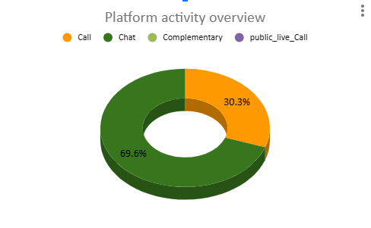
Platform Activity Overview
Key Insights:
Chat Dominance: Chats account for 70% of activity
Call Revenue: Calls generate higher revenue despite lower activity.
Recommendations:
Focus on monetization: Optimize agent performance and conversion tactics to increase revenue per chat session.

Slide 13
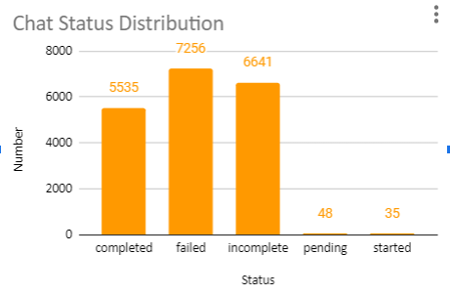
Chat Status Analysis
Key Insights:
High Failure & Incomplete Rates: Over 13,897 chats not resolved.
Opportunities for Improvement: Address reasons behind incomplete and failed chats.
Recommendations:
Improve Support Processes: Upgrade systems, train staff, reduce response times.
Implement Chat Automation: Use AI-powered chatbots for simpler queries.

Slide 14
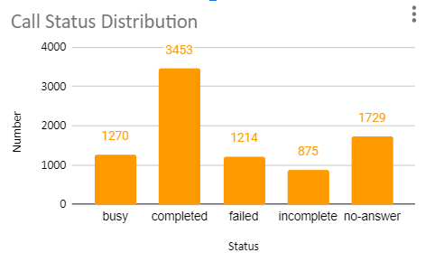
Call Status Analysis
Key Insights:
High Success Rate: 40% of calls completed.
Opportunities: Improve "No Answer," "Busy," and "Failed" categories.
Recommendations:
Optimize Call Timing: Implement automated callback system.
Improve Queue Management: Expand agent availability or improve call distribution.
Technical Improvements: Enhance infrastructure and agent training.

Slide 15
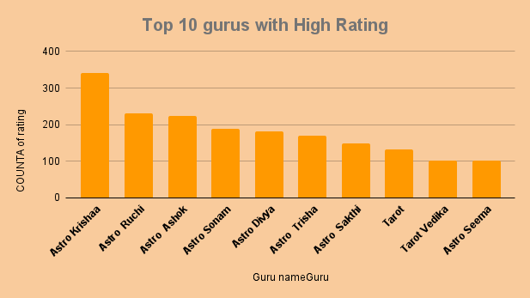
Top Performing Gurus
Key Findings:
Top Performers: Astro Krishna. and Astro Ruchi
Insights:
High Ratings: Top gurus have significantly higher ratings..
Recommendations:
Targeted Training: Focus on lower-rated gurus.
Customer Feedback: Encourage feedback for mid-tier gurus.
Best Practices Sharing: Create mentorship program.

Slide 16
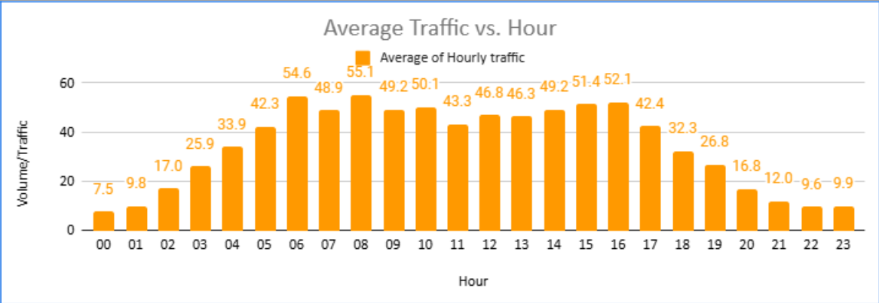
Average Traffic Distribution Analysis
Peak Hours: Daily traffic peaks between 6 AM and 4 PM.
Business Importance: This time period is crucial for the business.
Skill Requirement: Highly skilled professionals needed for optimal customer satisfaction.
Solution: Flexible staffing and shift optimization for efficient workload distribution.

Slide 17

Strategic Recommendations
Optimizing Technology for Uniform Workload Distribution
Recommendation:
Implement advanced call center technology.
Utilize predictive algorithms for peak traffic management.
Reason:
Current data shows imbalanced call handling.
Leads to agent burnout and inconsistent service quality.
Expected Impact:
Increased efficiency and faster response times.
Enhanced customer satisfaction during peak and off-peak hours.

Slide 18

Enhancing Customer Interactions Through Targeted Training
Recommendation:
Invest in targeted training programs.
Incorporate real-time feedback tools.
Reason:
Analysis shows high chat activity but low revenue.
Expected Impact:
Higher revenue through improved conversions.
Increased customer loyalty through personalized and empathetic interactions.

Slide 19
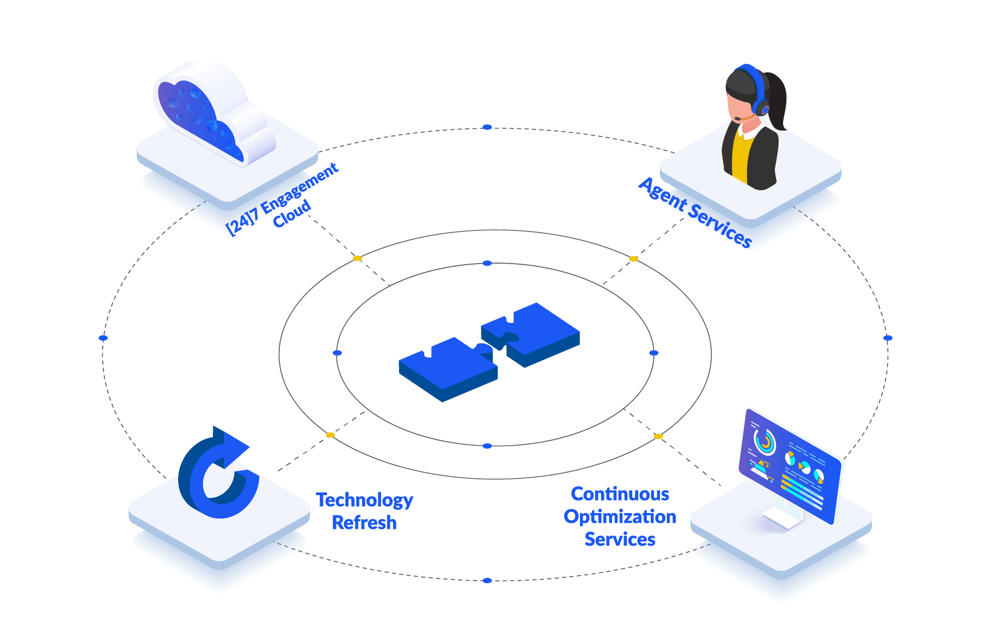
Optimizing Customer Service Technology
Recommendation:
Upgrade call center technology for real-time solutions.
Integrate AI-powered chatbots for initial triaging.
Optimize CRM tools for efficient query management.
Reason:
Significant gap between chat activity and revenue.
Expected Impact:
Increased market share through improved service scalability.
Enhanced customer experience with faster issue resolution and smoother service delivery.

Slide 20
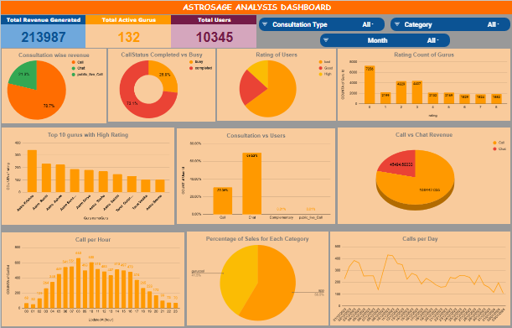
Analytical Dashboard

Slide 21

Conclusion
Key Findings:
High chat activity, low revenue.
Uneven workload distribution.
Training gaps.
Implications:
Operational Efficiency: Optimize technology and balance workload.
Revenue Growth: Improve agent training and upgrade technology.
Customer Satisfaction: Invest in technology and training.
Closing Statement: Implementing these data-driven recommendations will not only boost AstroSage's operational efficiency but also enhance customer satisfaction, leading to sustainable growth and competitive advantage in the market.

Slide 22


